Slide 1
Predicting depression
Using Bayesian Data Analysis Methods
Nghi Vo - 1029365 Khanh Ha - 1012042

Slide 2
table of contents
01
02
03
04
05
Introduction
Models
Results
A brief introduction and reason and reason for the analysis problem
A discussion of the used models and reasoning behind them
Interpretation of the results
DISCUSSION & CONCLUSION
PROBLEM EXPANSION
Further discussion and conclusion of the results
Link to further research or discussion

Slide 3
01
introduction

Slide 4
DEPRESSION IS a SERIOUS PROBLEM
According to WHO :
Depression is a common mental disorder. Globally, it is estimated that 5% of adults suffer from this mental condition.
Depression is a leading cause of disability worldwide and is a major contributor to the overall global burden of disease
On average, more women are more affected by depression than men
Depression can lead to suicide. But, there are treatments for mild, moderate and severe depression.
Resources link : WHO on Depression: https://www.who.int/news-room/fact-sheets/detail/depression

Slide 5

The situation worsen after the PAndemic
According to the Institute for Health Metrics and Evaluation (IHME):
Cases of anxiety and depression increased significantly after the COVID-19 pandemic, by roughly 25%
The younger part of the population were hit especially hard
Women were also more affected compared to men.
Resource link:https://www.healthdata.org/acting-data/new-ihme-analyses-show-depression-and-anxiety-among-top-causes-health-burden-worldwide

Slide 6
THE analysis problem
Thus, we decided to build models utilizing Bayesian Analysis methods to try and predict whether someone is afflicted with depression or not.
REASONING
DATASET
Because depression is so prevalence worldwide and is curable. Thus, it is crucial to help health professional diagnose the patient so the treatment process can go on smoothly.
The dataset we used is The Depression Dataset on Kaggle, with 55 entries total, 32 depressed patients and 23 non-depressed people
Resource link: The Depression dataset https://www.kaggle.com/datasets/arashnic/the-depression-dataset

Slide 7
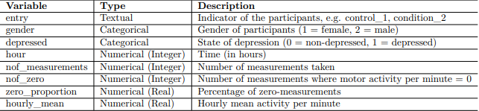
cLEANED data
After some cleaning, this is what we got:
Resources link: The Depression dataset https://www.kaggle.com/datasets/arashnic/the-depression-dataset
Depression - Dataset analysis and Machine Learning https://www.kaggle.com/code/samuelkali/depression-dataset-analysis-and-machine-learning

Slide 8
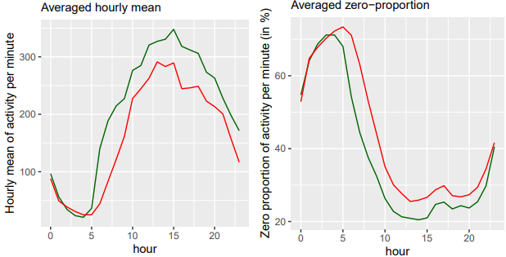
some initial analysis
We did something similar to what Samuel Oseh did in his attempt to tackle the problem and got these figures:
Based on the figures, we can see that on average, the non-depressed are more active, and, they are also quicker to become active after waking up.
The difference in activities is especially noticeable in the morning, between 6-9 AM with the difference at 7 AM being roughly 20%.
Thus, there’s a high chance that the zero-proportion at 7AM correlates with the person’s mental state, and this is chosen as a predictor for our Bayesian models
Trends analysis. Green = Non-depressed, Red = Depressed
Resources link: The Depression dataset https://www.kaggle.com/datasets/arashnic/the-depression-dataset
Depression - Dataset analysis and Machine Learning https://www.kaggle.com/code/samuelkali/depression-dataset-analysis-and-machine-learning

Slide 9
02
MODELS

Slide 10
THE MODELS USED
After some discussion, we decided to go with the following models.
NON-Hierarchical LOgistic regression
Hierarchical LOgistic regression
After discussing whether to use separate or pooled model, we decided to go with pooled model instead.
As mentioned, there’s a difference between the depression rate between male and female. Thus, we decided to form 2 hierarchical models based on gender.

Slide 11



POOLED Logistic Regression model
Function
Priors
x: predictor variable
α: log of the odds of the event
β: coefficient of the predictor variable (relationship)
After we fitted the data to a logistic regression model by minimizing mean square error, we have the above results.
Using these estimates, we have decided upon a weakly informative priors as followed:
Or
Thus, we have the likelihood of the model.
With:
y as the target label, being either 1 (depressed) or 0 (non-depressed)
x as the predictor, being the zero-proportion at 7 AM

Slide 12

Hierarchical Logistic Regression model
Function
Priors
As the model take into account the difference between male and female participants, we have the following likelihood:
Similar to the Pooled model, the prior distribution for 𝛼 remains the same
Where βi as the corresponding β for J groups
We initially assumed a weakly informative prior for 𝜇 similar to β, but, after some testings with low effective sample size, we decided to change 𝜇.
For the hyper parameter 𝜎, a non-negative inverse chi squared prior is chosen to ensure that the generated 𝜎 is non-negative.
After some more testings, we have the following prior distribution
We have the following distribution for β
With 𝜇 being the mean
𝜎 being the standard deviation
But as of now, their distributions are unknown and will be investigated further by the Bayesian model with prior distributions and samples

Slide 13
03
Results

Slide 14
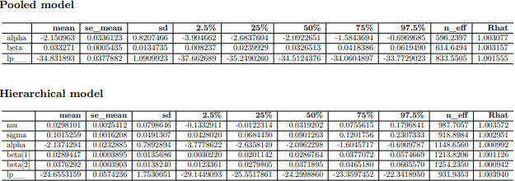
Convergence diagnostics
After running the models, we have the results summarized into a table:

Slide 15
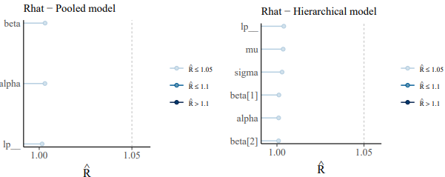
Convergence diagnostics
R_hat convergence diagnostics
As seen from the summary tables and plots, R_hat values for both models are very close to 1, and much lower than the 1.05 threshold, indicating that the chains have converged and the estimates are relatively reliable

Slide 16
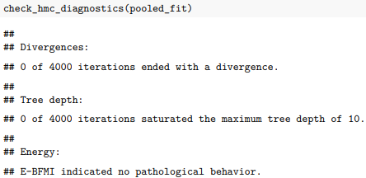

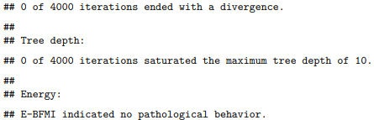
Convergence diagnostics
HMC convergence diagnostics
Using the functions from rstan to check, we have the following:
So, no divergences were detected in the iterations, and the maximum tree depth is not exceeded. Thus, the estimates are relatively reliable

Slide 17
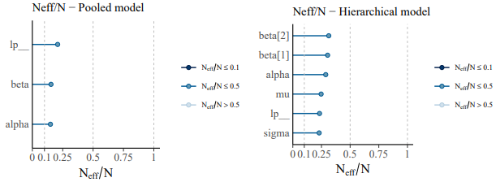
Convergence diagnostics
Effective sample size convergence diagnostics
The effective sample size represents the number of independent samples from the drawn samples, meaning, the closer the effective sample size to the drawn sample size, the more reliable.
Here, the ratios fall into the range between 0.1-0.5, while not good, they are above the minimum threshold.

Slide 18
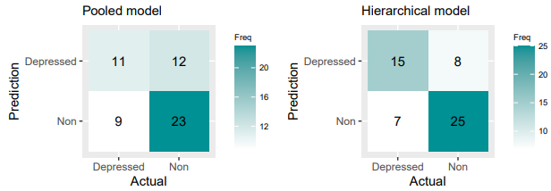
Posterior predictive checks
Here, we have drawn up a confusion matrix
Based on the matrix, the accuracy of the pooled model is 61.82% and the hierarchical model is 72.73%. The conditional probability of actual depression with positive prediction for the pooled model is rather low at 47.83% while the hierarchical model achieved a higher probability at 65.22%.From this, the hierarchical model seems to perform better than the pooled model.

Slide 19

Predictive performance assessment
The performance assessment will be conducted in a similar manner to the posterior predictive check.
Because of the small dataset, splitting into training and testing set will be difficult and the results produced will be unreliable, we decided to use KFold cross validation (5 folds). The original data set is divided into 5 smaller data sets, and for each iteration, 4 sets are used for training and 1 for testing. At the end, the accuracy scores and conditional probabilities are averaged and reported.
From the results, we have the following table:
Based on the table, the performance of both models are decent with hierarchical model performing slightly better

Slide 20


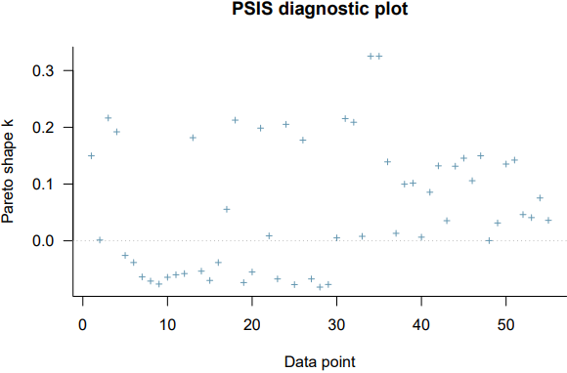
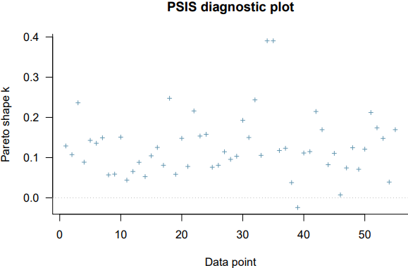
Models comparison
We decided to compare the models using PSIS-LOO diagnostics
Pooled model:
Hierarchical model:
All Pareto-k values are below the 0.7 threshold, meaning that both models generate relatively reliable estimates. However, the elpd_loo value of the pooled model is higher, meaning that the pooled model will perform better according to the PSIS-LOO diagnostics

Slide 21

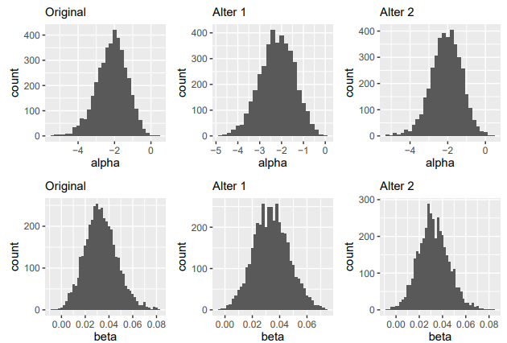
Prior sensitivity analysis
Pooled model
We have the following priors that were used:
For the sensitivity test, we used the following priors
Case 1 : changing 𝛼
Case 2 : changing 𝛽
We have the following figures:
Based on the graph, we can see that, the different prior distributions do not make a significant impact on the posterior distributions.
This means that the pooled model is not sensitive to changes in prior distributions

Slide 22

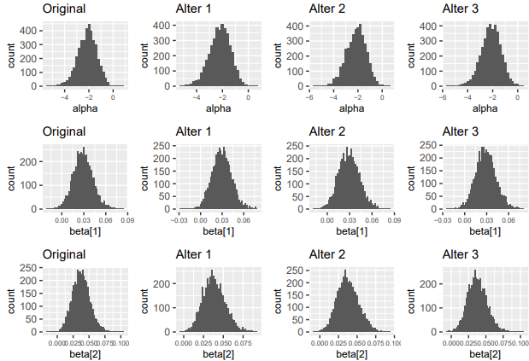
Prior sensitivity analysis
Hierarchical model
We have the following priors that were used:
For the sensitivity test, we used the following priors
Case 1 : changing 𝛼
Case 2 : changing 𝜇
Case 3 : changing 𝜎
We have the following figures:
Based on the graph, we can see that, the different prior distributions do not make a significant impact on the posterior distributions.
This means that similar to the pooled model, the hierarchical model is not sensitive to changes in prior distributions

Slide 23
04
DisCOVERies and CONCLUSION

Slide 24
DisCOVERIES CONCLUSION:
Convergence
PERFORMANCE
Contradiction
Based on all the tests, both models have converged, thus, their estimates are reliable.
The model performance is decent, but there are rooms for improvement.
Based on most of the test, the hierarchical model seems to perform better, but, the PSIS-LOO diagnosis, gives us a different result, with the pooled model being better
pROBLEM
Noteworthy FINDINGS
IMPROVEMENT
Because of the small sample size, it easy quite easily influenced by outlier.
We don’t have a deep enough understanding on the subject
Based on the results, we can see that depression in male participants have a slightly higher coefficient for correlation than female based on the hierarchical model.
Our prior choices can be improved with the health of expert in the field. We can use another predictor like the MADRS scored discussed in the dataset page on Kaggle.

Slide 25
Conclusion:
SELF-reflection:
In conclusion, the results we have gathered from the models are good but there are rooms for improvement. Furthermore, the models as of now are quite simple and can be a basis for further research, giving us more reasons and motivations to work on a more specialized and complete model of Bayesian analysis.
The project so far has been a positive experience for us.
It allows us to utilize and internalize all that was taught throughout the course.
We were able to learn the workflow of a Bayesian Data Analysis project.
We have also learnt about various skills needed for a Data analysis project in general.

Slide 26
05
PROBLEM EXPANSION

Slide 27
MADRS
More than depression
In this project, the parameter that we used to identify depression is motor activity, but there is a more useful parameter which is MADRS score, which can also give the state of the depressed patient, ranging from mild to severe.
The article can be found using this link:
https://www.ncbi.nlm.nih.gov/pmc/articles/PMC6878407/
From an article that we read, it seems that motor activities also correlate with other mental condition like schizophrenia, sometimes, even more than depression.
The article can be found using this link : https://bmcresnotes.biomedcentral.com/articles/10.1186/1756-0500-3-149

